Slide 1


A summary of
The education services analysis
A presentation to
Goshen Central school district
Board of education
June 23, 2025

Slide 2

Your Presenters
John McGuire, M.Ed., SDA
Senior Associate
Michael Neiman, Ph.D. CCC
Managing Director
Alliance education associates, LLC

Slide 3
Presentation Overview
The primary purposes of this presentation to the BOE are to:
1. Review the methodology of the study
2. Present pertinent information for contextual purposes
3. Provide key Findings
4. Provide corresponding Areas of Opportunity
5. Provide a forum for discussion

Slide 4
Specific Areas of the Review
1. Continuum of Services
2. Related Services
3. Utilization of Para-Professional Supports
4. Out of District Placements
5. Organizational Structure and District Coordination of Programs and Services
6. District Finances Related to Recoupment of Medicaid

Slide 5

Organization of the Presentation
The program report, and this corresponding presentation, are organized with respect to two main areas:
Organizational Considerations
Continuum of Supports
Each will be considered when we discuss Findings and Areas of Opportunity.

Slide 6
Methodology
  Interviews
Sixty-eight (68) confidential interviews with central office leadership, school-based administration, certified teachers, para-professionals, related service providers, and parents.
Questions were catered to the interviewees’ particular areas of expertise and relevance to the areas under review.
Comparative analyses to other average resource/need districts within Orange County and New York State regarding student outcome and financial data
Document Reviews

Slide 7
Organizational Considerations
Culture and Climate
.
.
Findings
  It was generally perceived that ownership was variable and was greater among general education administrators and teachers who had been involved in collaborations with special education colleagues.
  Another variable that is correlated with culture and climate is the morale associated with the changing student demographic experienced in recent years by the District. The reported impact of this change was perceived to be that student needs were approaching and exceeding District capacities to address them.

Slide 8
Organizational Considerations
Culture and Climate
.
.
Findings (cont.)
  The 3-year average of District SWDs spending at least 80% of their school day in general education is just under 50%; which is significantly below the State Target (of approximately 59%) but it is higher than the average of the ACSDs and a 6% increase from the previous 3 years.

Slide 9
Organizational Considerations
Culture and Climate
.
.
Findings (cont.)

Slide 10
Organizational Considerations
Culture and Climate
.
.
Areas of Opportunity
  Develop Professional Learning Communities at all schools that involve the integration of special education and regular education personnel including trainings for principals.
  Create a mission statement explicitly containing elements of general and special education and make this visible to personnel at all schools.
  If contractual parameters allow, expand the teacher evaluation process.
  As new teachers are hired in the District, provide all principals with an operational hiring guide.

Slide 11
Organizational Considerations
CSE Processes
.
.
Findings
  Interviewees reported that the processes and procedures of the CSE were generally known and understood by participant stakeholders.
  There was not an awareness of written guidelines for eligibility for and exit from the various instructional programs.
  There were few incidences of confusion or inappropriate requests for District services under a medical model.

Slide 12
Organizational Considerations
CSE Processes
.
.
Areas of Opportunity
  As part of leadership’s plan to update processes and procedures, it may also be beneficial to re-visit the establishment of descriptions that further define the in-District continuum of programs.
  Continue to develop, refine, and utilize clearly articulated written program descriptions and eligibility and exit guidelines for instructional programs, related services, paraprofessional supports, and testing accommodations and modifications.

Slide 13
Organizational Considerations
Staff Support
.
.
Findings
  There was an expressed appreciation for District support with professional development, with an expressed desire for more opportunities on topics of current and emerging importance with relevance to their respective domains and practices. It was the consensus of respondents that the District does provide sufficient instructional materials, and technologies to support and enable the teaching and learning process.
  With respect to the FTEs in central office, there are two administrators overseeing Pupil Personnel Services, which equates to a ratio of 1 central office administrator for every 290 CSE and CPSE students. In the author’s experience this is a lean model compared to expected ratios.

Slide 14
Organizational Considerations
Staff Support
.
.
Areas of Opportunity
  Continue to provide PD with thematic relevance and, if budgets allow, expand allowances for staff to access required continuing education opportunities. Develop Professional Learning Communities at all schools that involve the integration of special education and regular education personnel.
  Explore increasing school-based administrative capacity to allow the special education director to focus on more global programmatic enhancements, consider creating a scope and sequence of a “Special Education 101” monthly Professional Learning Community, which could be led by a special education administrator or another facilitator.
  .

Slide 15
Organizational Consideration
Staffing
.
.
Findings
  As indicated below, the District’s personnel, with the exception of Occupational Therapy, is within expectations across all other disciplines.

Slide 16
Organizational Considerations
Staffing
.
.
Areas of Opportunity
  As is in process, the District is encouraged to re-visit systematic, District-wide entry and exit criteria for related services.
  Specific to Instructional Assistants, the District may consider adding quantitative parameters for eligibility for paraprofessional supports. In this manner, further parity, and equalization of access to services can be ensured for the students across the District.

Slide 17
Organizational Consideration
Expenditures
.
.
Findings
  As indicated in the illustration below, the District’s expenditures devoted to special education (as expressed by per student cost) is lower than the ACSD average.

Slide 18
Continuum of Supports
MTSS
.
.
Findings
  The District had undertaken efforts to develop and implement MTSS, including conducting professional development with Jim Wright, and hiring two interventionists at each of its four schools. At the time of the site visits, interviewees described the implementation as variable, incremental, very much a work in progress and in need of further attention.
  MTSS was viewed as furthest along at the elementary level (Intermediate School). Some respondents were not involved, and others were unaware of the status of MTSS in their schools.

Slide 19
Continuum of Supports
MTSS (cont.)
.
.
Findings
  Professional development in intervention strategies for classroom teachers at Tier 1 was an expressed need.
  From a quantitative perspective, as indicated in Figure 4 below, special education enrollments have decreased by 1% in the last 5 years (Figure 1 below), compared to increases at both the State (.9%) and ACSD (.6%) across the same time period. The current special education population of 14% is lower than the ARSD average and exactly in-line with the state average. The overall percentage of SWDs with high incidence, low needs of 76% (comprising learning disability-27%, other health impaired-29%, and speech or language impairment-20%) is in-line with ACSD and State averages.

Slide 20
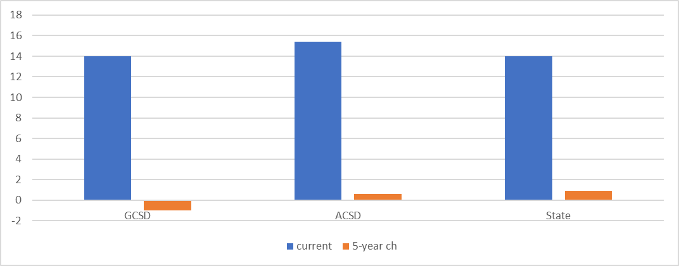
Continuum of Supports
MTSS (cont.)
.
.

Slide 21
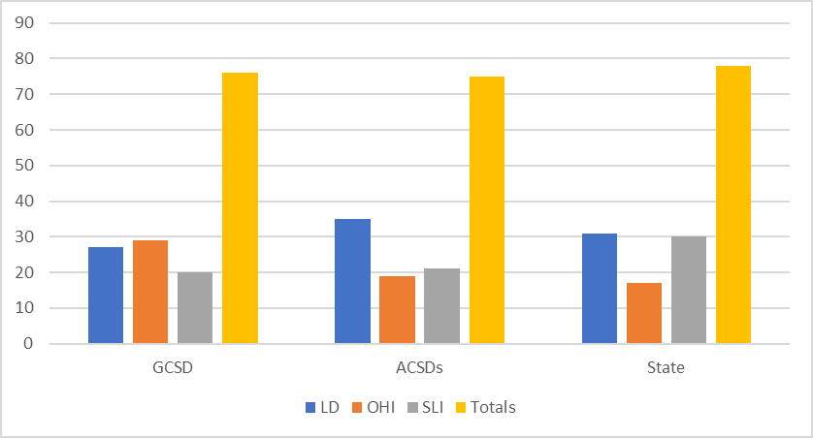
Continuum of Supports
MTSS (cont.)
.
.

Slide 22
Continuum of Supports
RtI
.
.
Areas of Opportunity
  As part of the hiring process ensure that all teachers understand the ownership standard of their jobs.
  Consider a “reverse” MTSS process.

Slide 23
Continuum of Supports
In-District Special Education Programs
.
.
Findings
  The District had established a continuum of special education instructional programs, as follows:
  Elementary and Intermediate Schools – 6:1:2 (K-5); 8:1:2 (K-2); 8:1:1 (3-5); 15:1 (K-5); ICT (K-5); CT (Dir and Ind) (K-5); Resource Room (K- 5); and Related Services K-5).
  Middle School – 15:1 (Core Subjects) (6-8); ICT (Core Subjects) (6-8); CT (Dir. and Ind.) (6-8); Res. Room (6-8); and Related Services.
  High School – 15:1 (Core Subjects (9-12); 12:1:1 Life Skills; ICT (Core Subjects) (9-12); CT (Dir. and Ind.) (9-12); Res. Room (9-12); and Related Services.

Slide 24
Continuum of Supports
In-District Special Education Programs (cont.)
.
.
  With respect to student achievement, it is notable that as indicated in Figure 5, the District’s achievement gap has also closed in the last 5 academic school years for math (-2) but increased 7 for ELA.

Slide 25
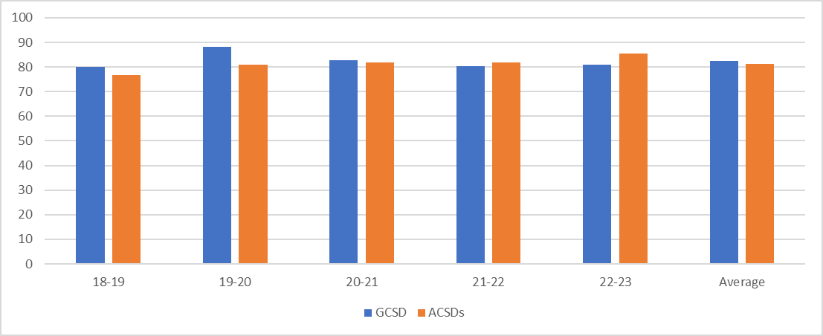
Continuum of Supports
In-District Special Education Programs
.
.
  The District’s graduation 5-year rate for the SWD cohorts is 82.4 and is a full point higher than the ACSDs during this same time period. It is notable that the IEP review suggested Transition Plans for secondary students were consistently well-written and complete.

Slide 26
Continuum of Supports
In-District Special Education Programs
.
.
Areas of Opportunity
  Introduce vertical articulation teams.
  Continue to assess the ICT model at all schools to ensure there is adequate co-planning, general education-special education dyads, and master scheduling of students to ensure its optimal success. Expand RSP roles in co-teaching.
  There are several suggestions in the report to improve graduation rates for all SWDs.

Slide 27
Continuum of Supports
Out of District Placements
.
.
Primary Findings
  Those responding was that the out of District program placements were appropriate to the needs of the individual students. The data is consistent with this perception with respect to the percentage of SWDs in OODs and the demographics (e.g., grade and types of disabilities).
Areas of Opportunity
  Continue to focus on requisite capacities to serve SWDs in the District.

Slide 28
Summary and Final Commentary
.
.
This analysis revealed many celebrations and areas of commendation that include staffing levels that are within expectations, staffing levels that “across the board” are within expectations, and SWD graduation rates. The authors also identified several areas of opportunities that leadership may consider enhancing its programming for struggling and differently-abled learners, which we are including under the original corresponding components in the document.

Slide 29
Summary and Final Commentary (cont.)
.
.
The authors postulate that the following areas may be of most immediate value in that they have both programmatic and fiscal implications and are offered for consideration as part of the District’s strategic planning and, although the two areas are intertwined, we have presented them with respect to organizational and programmatic considerations.

Slide 30
Summary and Final Commentary (cont.)
.
.
  Organizational Considerations
  Develop and implement a plan for addressing and implementing strategies for more effective collaboration, communication and work on common goals amongst all stakeholder groups serving students with disabilities.
  Continue efforts to promote a pervasive culture of ownership for SWDs.
  Engage in and model effective professional leadership practices.
  Consider enhancements to the District’s professional development processes and offerings.

Slide 31
Summary and Final Commentary (cont.)
.
.
  Programmatic Considerations
  Develop and utilize clearly articulated program descriptions and eligibility and exit guidelines.
  Revisit the district RtI plan (to include an array of instructional approaches), revise as necessary, disseminate, and provide professional development for implementation of a comprehensive system of RtI/MTSS (K-12), as a General Education initiative.
  Continue efforts to serve students with disabilities in the least restrictive environments with requisite ICT capacities and coordination.
  Develop eligibility and exit guidelines for related services.
  Create vertical articulation teams.

Slide 32
Medicaid Reimbursement
The District has not submitted for Municipal Medicaid reimbursement since 2013. In that year, it received a total of $ 784.53.

Slide 33

Medicaid Reimbursement (cont.)
  In addition, our review of the utilization of the District IDEA grants, we identified Medicaid eligible services (Psychological Services) which may be being provided to Medicaid eligible students. Use of these federal funds precludes the District from filing for Medicaid reimbursement for these services.
  CAVEAT: However, if the service delivery being provided is benefiting the student, the District may wish to consider forgoing Medicaid reimbursement for those services.
  Assumption: Our assumption regarding the potential Medicaid revenue amount is that all Medicaid eligible students receive all Medicaid eligible services which are required in their respective IEP’s and that those services are all provided by Medicaid certified providers.

Slide 34
Medicaid Reimbursement (cont.)
CONCLUSION: As of June 30, 2023, the District has not received nor has it submitted for Medicaid reimbursement revenue, for its Medicaid eligible students receiving Medicaid eligible services. We estimate that the District potential Medicaid revenue for all potential eligible students and for all eligible services is approximately $365,523 annually.
“LOW HANGING FRUIT:” Should the District choose to bill only for the primary Medicaid related services of Occupational Therapy, Physical Therapy and Speech and Language Services, it would receive approximately $ 316,197 annually. It could then expand it’s initial billing to include those additional Medicaid eligible services in the future.
RECOMMENDATION: In the future, the Medicaid eligibility determination should be integrated into the special education intake process and allow for electronic signatures for the Parental Authorization Form.

Slide 35
QUESTIONS-DISCUSSION

